Slide 1

Operating systems
Introduction and Process Management
Venkatesh Prasad
Department of Computer Science

Slide 2
OPERATING SYSTEMS
Slides Credits for all PPTs of this course
The slides/diagrams in this course are an adaptation, combination, and enhancement of material from the following resources and persons:
Slides of Operating System Concepts, Abraham Silberschatz, Peter Baer Galvin, Greg Gagne - 9th edition 2013 and some slides from 10th edition 2018
Some conceptual text and diagram from Operating Systems - Internals and Design Principles, William Stallings, 9th edition 2018
Some presentation transcripts from A. Frank – P. Weisberg
Some conceptual text from Operating Systems: Three Easy Pieces, Remzi Arpaci-Dusseau, Andrea Arpaci Dusseau

Slide 3
Operating systems
Named and Unnamed Pipes
Venkatesh Prasad
Department of Computer Science

Slide 4
OPERATING SYSTEMS
Pipes
Acts as a conduit allowing two processes to communicate
Issues:
Is communication unidirectional or bidirectional?
In the case of two-way communication, is it half or full-duplex?
Must there exist a relationship (i.e., parent-child) between the communicating processes?
Can the pipes be used over a network?
Ordinary (Unnamed) pipes – cannot be accessed from outside the process that created it. Typically, a parent process creates a pipe and uses it to communicate with a child process that it created.
Named pipes – can be accessed without a parent-child relationship.
Notes:
Every time you type a sequence of commands in a pipeline for the shell to execute, the shell creates a separate process for each command and links the standard output of one to the standard input of the next using a pipe.

Slide 5
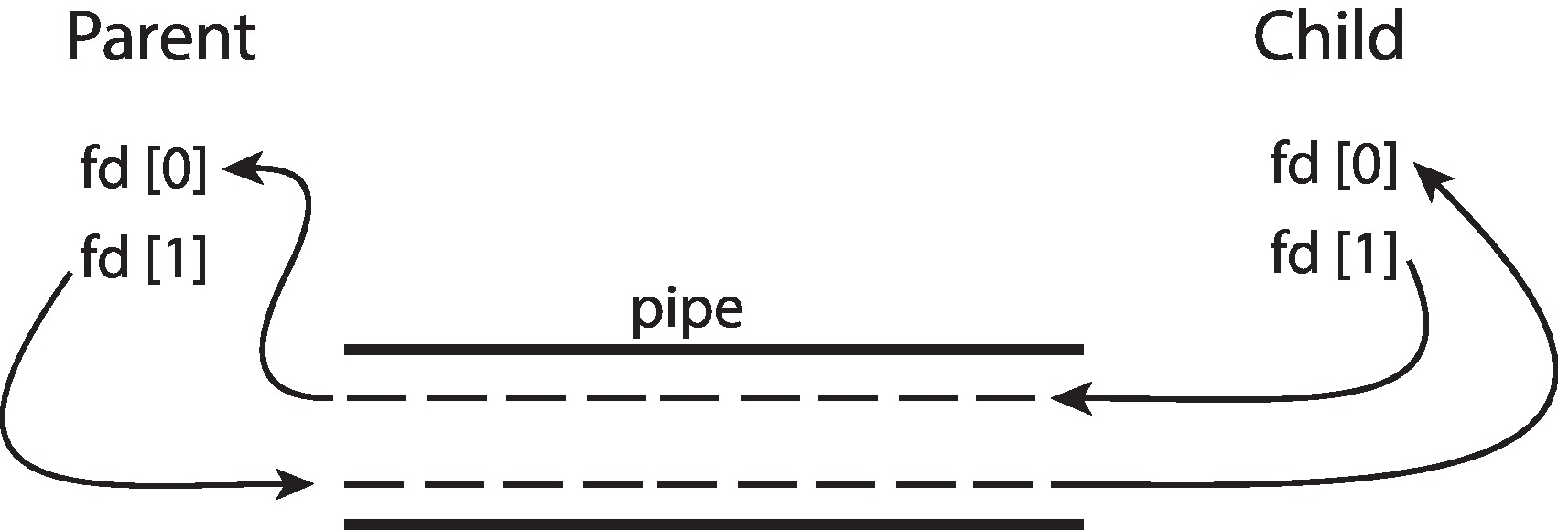
OPERATING SYSTEMS
Ordinary Pipes
Ordinary Pipes allow communication in standard producer-consumer style
Producer writes to one end (the write-end of the pipe)
Consumer reads from the other end (the read-end of the pipe)
Ordinary pipes are therefore unidirectional
Require parent-child relationship between communicating processes
Windows calls these anonymous pipes
Used by the shell; not used very often by application programs
Main limitation is processes need to be related

Slide 6
OPERATING SYSTEMS
Named Pipes
Named Pipes are more powerful than ordinary pipes
Communication is bidirectional
No parent-child relationship is necessary between the communicating processes
Several processes can use the named pipe for communication
Provided on both UNIX and Windows systems.
Limitations of named pipes:
Two pipes needed for two way communication
FIFO: Data once retrieved is removed from pipe

Slide 7
OPERATING SYSTEMS
Named Pipes (Cont.)
On UNIX Systems:
Named Pipes are referred to as FIFOs
appear as typical files in the file system
Created with the system call mkfifo() and manipulated with open(), read(), write() and close() system calls
Only half-duplex transmission is permitted; 2 FIFOs are used for data travel in both directions
Allows only byte-oriented data transmission across a FIFO
Communicating processes must reside on the same machine

Slide 8
OPERATING SYSTEMS
Named Pipes (Cont.)
On Windows systems:
Created with the function CreateNamedPipe() and manipulated with ConnectNamedPipe(), ReadFile(), WriteFile() and DisconnectNamedPipe() functions
Full duplex transmission is permitted
Communicating processes may reside on the same or different machines
Allows byte- or message-oriented data transmission

Slide 9

THANK YOU
Venkatesh Prasad
Department of Computer Science Engineering
venkateshprasad@pes.edu

